Slide 1

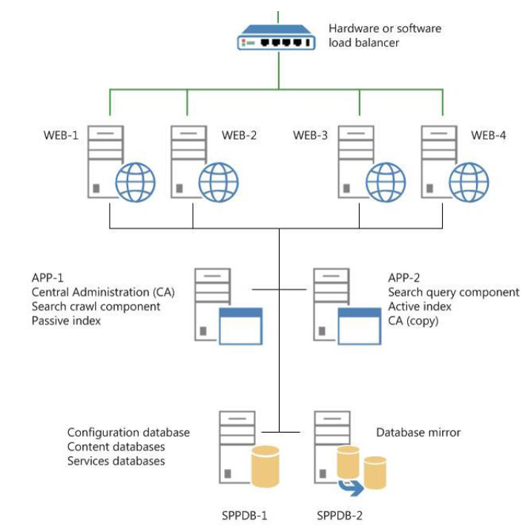
Snap-On Managed Services
The Challenge
<p>Snap-on is a leading global developer, manufacturer and marketer of tool and equipment solutions for professional tool users. Snap-on has more than 22,000 products, operates in more than 130 countries and employs approximately 11,000 people worldwide. Snap-on also has a franchise network of more than 4,200 franchises. After working unsuccessfully with a separate vendor on their collaboration platform, Snap-on engaged with Affirma. It became apparent, they were not receiving a consultative approach to the platform as well as ongoing oversight and support for their infrastructure services.</p>
What We Did
<p>Affirma evaluated their existing SharePoint Environment and delivered findings and recommendations. We proposed an ongoing support engagement model that better met their long term goals and strategy around collaboration.</p>
Results
<p>We delivered a managed collaboration platform meeting core business requirements. Overseeing their environment ongoing allows them to focus on their business while ensuring their business critical collaboration platform is running and meeting the business needs.</p>

